Slide 1


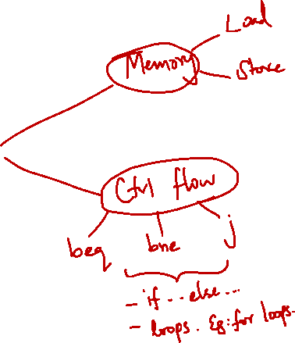
http://www.comp.nus.edu.sg/~cs2100/
Lecture #8
MIPS
Part II: More Instructions

Slide 2
Lecture #8: MIPS Part 2: More Instructions
Memory Organisation (General)
1.1 Memory: Transfer Unit
1.2 Memory: Word Alignment
MIPS Memory Instructions
2.1 Memory Instruction: Load Word
2.2 Memory Instruction: Store Word
2.3 Load and Store Instructions
2.4 Memory Instruction: Others
2.5 Example: Array
2.6 Common Questions
2.7 Example: Swapping Elements

Slide 3
Lecture #8: MIPS Part 2: More Instructions
Making Decisions
3.1 Conditional Branch: beq and bne
3.2 Unconditional Jump: j
3.3 IF statement
3.4 Exercise #1: IF statement
Loops
4.1 Exercise #2: FOR loop
4.2 Inequalities
Array and Loop
Exercises

Slide 4
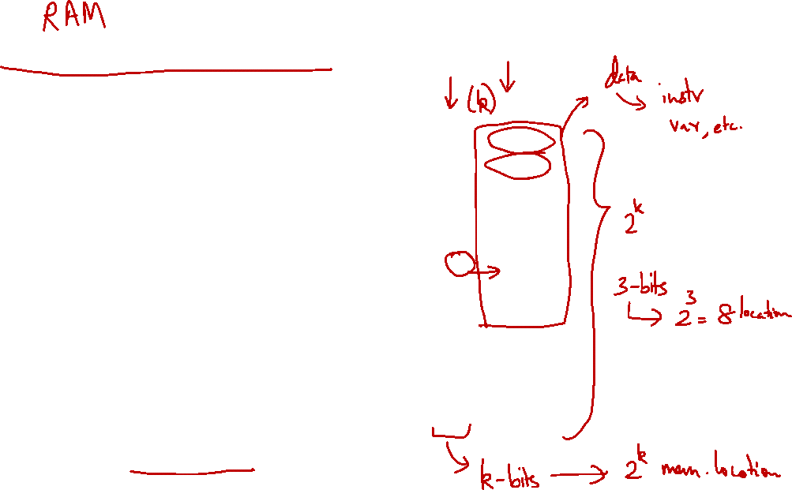
1. Memory Organisation (General)
The main memory can be viewed as a large, single-dimension array of memory locations.
Each location of the memory has an address, which is an index into the array.
Given a k-bit address, the address space is of size 2^{k}.
The memory map on the right contains one byte (8 bits) in every location/address.
This is called byte addressing
Address
Content
0
8 bits
1
8 bits
2
8 bits
3
8 bits
4
8 bits
5
8 bits
6
8 bits
7
8 bits
8
8 bits
9
8 bits
10
8 bits
11
8 bits
:

Slide 5
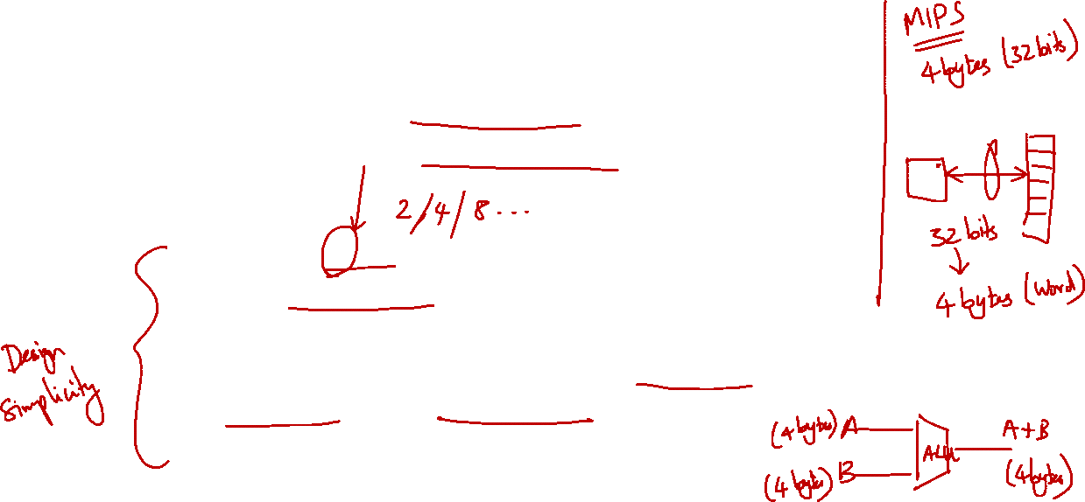
1.1 Memory: Transfer Unit
Using distinct memory address, we can access:
a single byte (byte addressable) or
a single word (word addressable)
Word is:
Usually 2^{n} bytes
The common unit of transfer between processor and memory
Also commonly coincide with the register size, the integer size and instruction size in most architectures

Slide 6
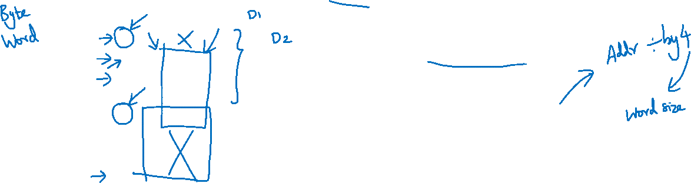
1.2 Memory: Word Alignment
Word alignment:
Words are aligned in memory if they begin at a byte address that is a multiple of the number of bytes in a word.
Example: If a word consists of 4 bytes, then:
Address
Aligned word
0
Byte 0
1
Byte 1
Mis-aligned word
2
Byte 2
3
Byte 3
Question:
How do we quickly check whether a given memory address is word-aligned or not?
4
Byte 4
5
Byte 5
6
Byte 6
7
Byte 7

Slide 7
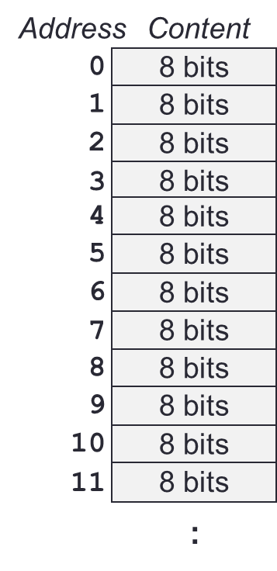
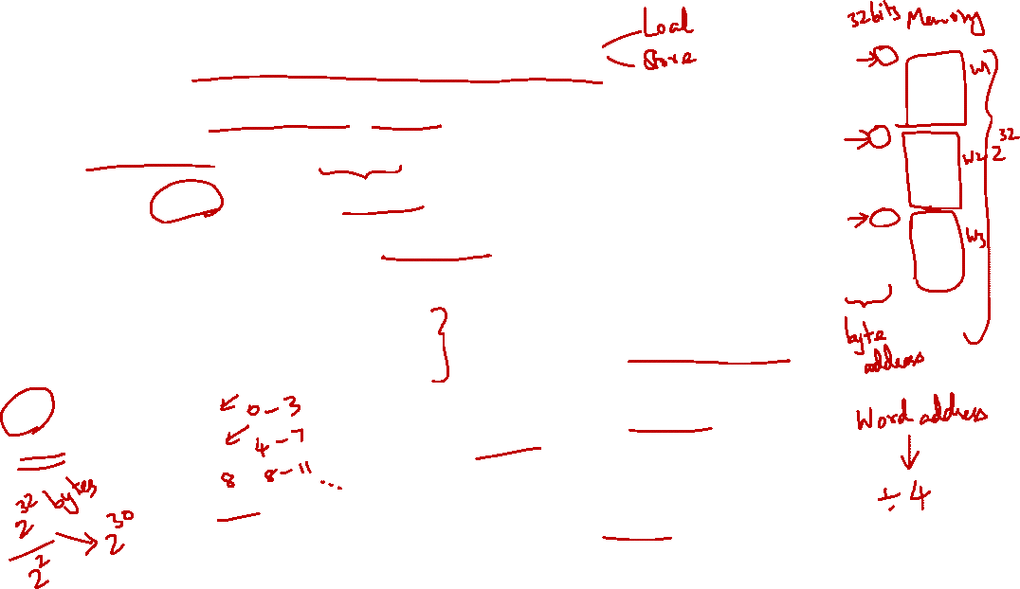
2. MIPS Memory Instructions
MIPS is a load-store register architecture
32 registers, each 32-bit (4-byte) long
Each word contains 32 bits (4 bytes)
Memory addresses are 32-bit long
NOTE:
Magic number is 32
Name | Examples | Comments
32 registers | $s0-$s7, $t0-$t9, $zero, $a0-$a3, $v0-$v1, $gp, $fp, $sp, $ra, $at | Fast processor storage for data. In MIPS, data must be in registers to perform arithmetic.
2³⁰ memory words | Mem[0], Mem[4], …, Mem[4294967292] | Accessed only by data transfer instructions. MIPS uses byte addresses, so consecutive words differ by 4. Memory holds data structures, such as arrays, and spilled registers, such as those saved on procedure calls.

Slide 8
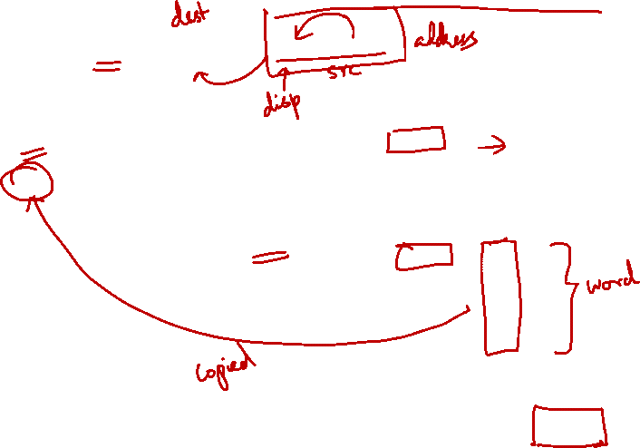
2.1 Memory Instruction: Load Word
Example: lw $t0, 4($s0)
Processor
Memory
………..
$s0
8000
8000
8001
$t0
1
8002
8003
Offset = +4
8004
8005
2
8006
8007
………..
Steps:
Memory Address = $s0 + 4 = 8000 + 4 = 8004
Memory word at Mem[8004] is loaded into $t0

Slide 9
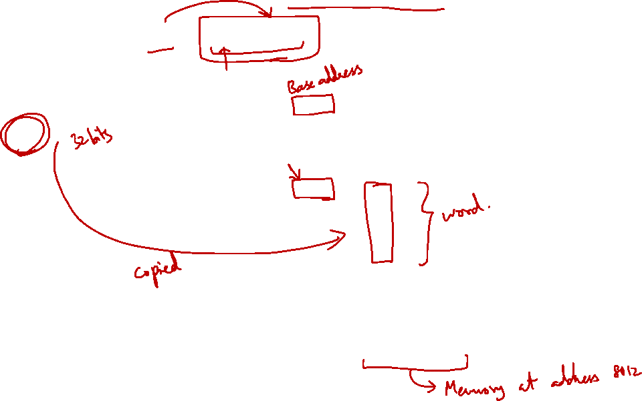
2.2 Memory Instruction: Store Word
Example: sw $t0, 12($s0)
Processor
Memory
………..
$s0
8000
8000
8001
$t0
1
8002
……
………
Offset = +12
8012
8013
2
8014
8015
………..
Steps:
Memory Address = $s0 + 12 = 8000 + 12 = 8012
Content of $t0 is stored into word at Mem[8012]

Slide 10
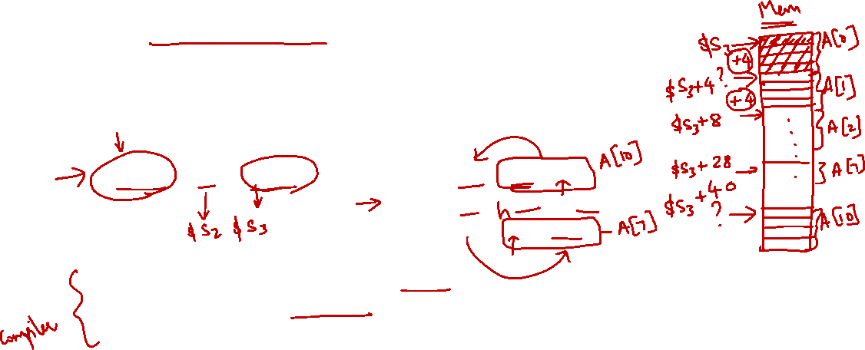
2.3 Load and Store Instructions
Only load and store instructions can access data in memory.
Example: Each array element occupies a word.
Each array element occupies a word (4 bytes).
$s3 contains the base address (address of first element, A[0]) of array A. Variable h is mapped to $s2.
Remember arithmetic operands (for add) are registers, not memory!
C Code | MIPS Code
A[7] = h + A[10];
lw $t0, 40($s3)
add $t0, $s2, $t0
sw $t0, 28($s3)

Slide 11

2.4 Memory Instructions: Others (1/2)
Other than load word (lw) and store word (sw), there are other variants, example:
load byte (lb)
store byte (sb)
Similar in format:
lb $t1, 12($s3)
sb $t2, 13($s3)
Similar in working except that one byte, instead of one word, is loaded or stored
Note that the offset no longer needs to be a multiple of 4

Slide 12

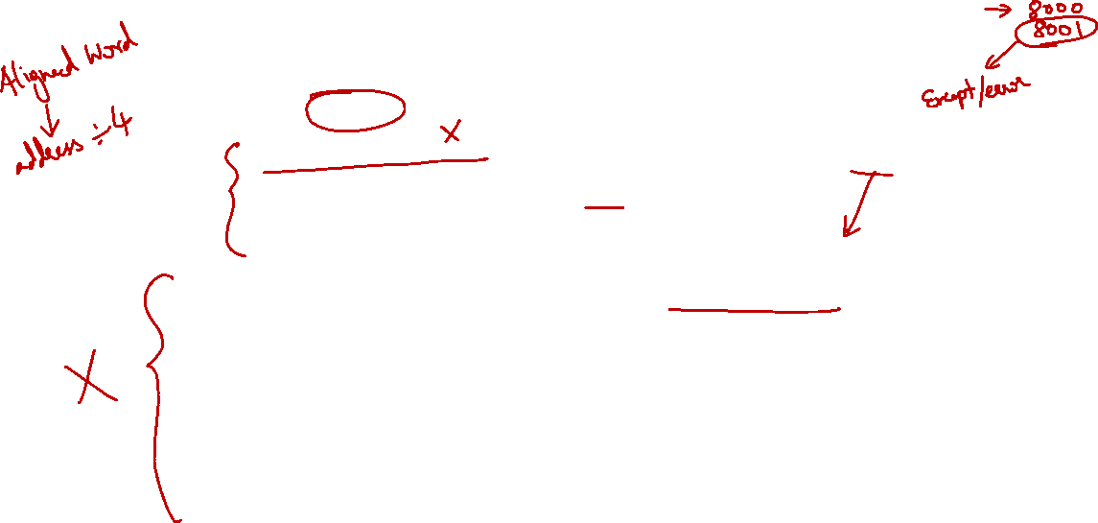
2.4 Memory Instructions: Others (2/2)
MIPS disallows loading/storing unaligned word using lw/sw:
Pseudo-Instructions unaligned load word (ulw) and unaligned store word (usw) are provided for this purpose
Other memory instructions:
lh and sh: load halfword and store halfword
lwl, lwr, swl, swr: load word left / right, store word left / right.
etc…
NOTE:
ulw/usw can be translated to sequence of lb/sb + other operations

Slide 13
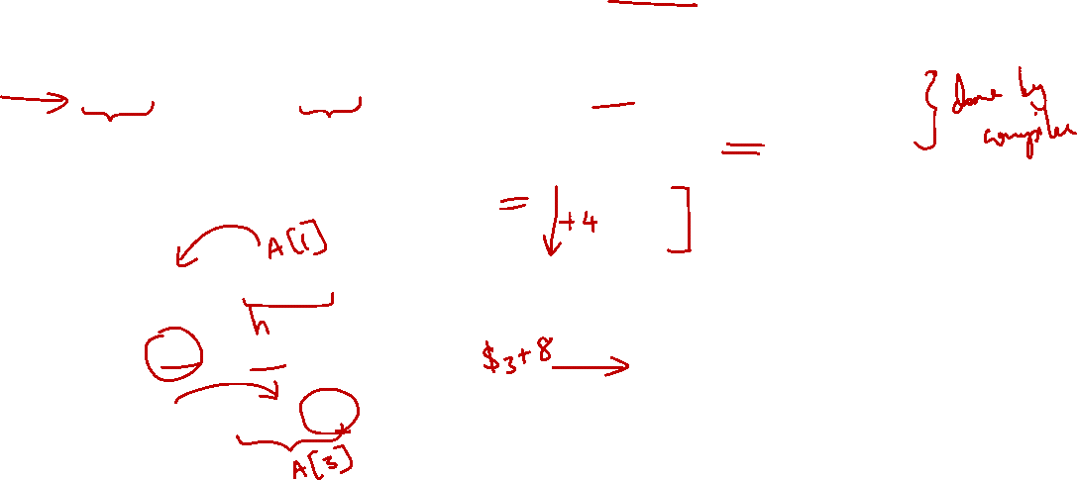
2.5 Example: Array (assume 4 bytes per element)
C Statement to translate | Variables Mapping
A[3] = h + A[1]; | h ➔ $s2 base of A[] ➔ $s3
$s3
A[0]
t0 = A[1];
t0 = h + t0;
A[3] = t0;
lw $t0, 4($s3)
add $t0, $s2, $t0
sw $t0, 12($s3)
4($s3)
A[1]
A[2]
12($s3)
A[3]

Slide 14
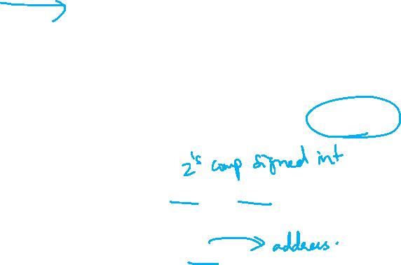
2.6 Common Questions: Address vs Value
Key concept:
Registers do NOT have types
A register can hold any 32-bit number:
The number has no implicit data type and is interpreted according to the instruction that uses it
Examples:
add $t2, $t1, $t0
➔ $t0 and $t1 should contain data values
lw $t2, 0($t0)
➔ $t0 should contain a memory address

Slide 15
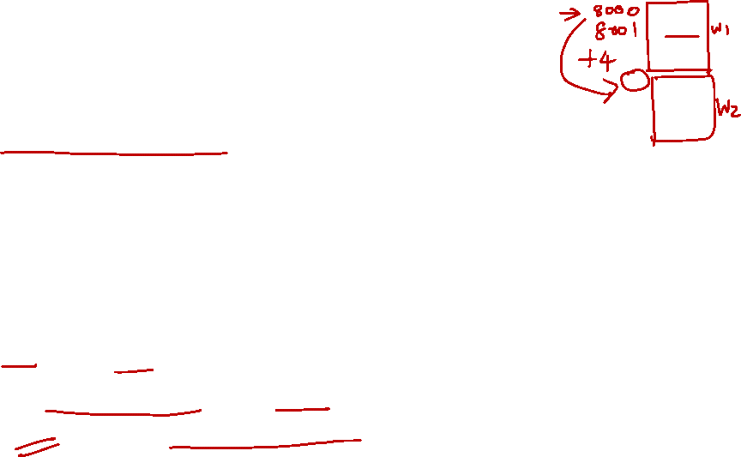
2.6 Common Questions: Byte vs Word
Important:
Consecutive word addresses in machines with byte-addressing do not differ by 1
Common error:
Assume that the address of the next word can be found by incrementing the address in a register by 1 instead of by the word size in bytes
For both lw and sw:
The sum of base address and offset must be a multiple of 4 (i.e. to adhere to word boundary)

Slide 16
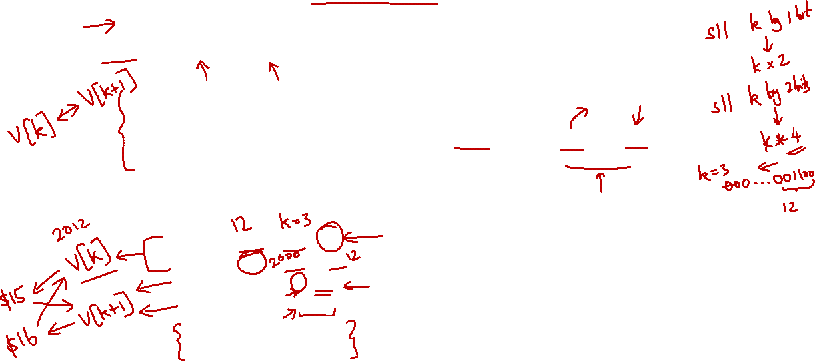
2.7 Example: Swapping Elements
C Statement to translate | Variables Mapping
swap( int v[], int k ) { int temp; temp = v[k] v[k] = v[k+1]; v[k+1] = temp; } | k ➔ $5 Base address of v[] ➔ $4 temp ➔ $15
Example: k = 3; to swap v[3] with v[4].
Assume base address of v is 2000.
$5 (k) ← 3
$4 (base addr. of v) ← 2000
swap:
sll $2, $5, 2
add $2, $4, $2
lw $15, 0($2)
lw $16, 4($2)
sw $16, 0($2)
sw $15, 4($2)
$2 ← 12
$2 ← 2012
$15 ← content of mem. addr. 2012 (v[3])
$16 ← content of mem. addr. 2016 (v[4])
content of mem. addr. 2012 (v[3]) ← $16
content of mem. addr. 2016 (v[4]) ← $15

Note: This is simplified and may not be a direct translation of the C code.

Slide 17
Reading
Instructions: Language of the Computer
Read up COD Chapter 2, pages 52-57. (3rd edition)
Read up COD Section 2.3 (4th edition)

Slide 18
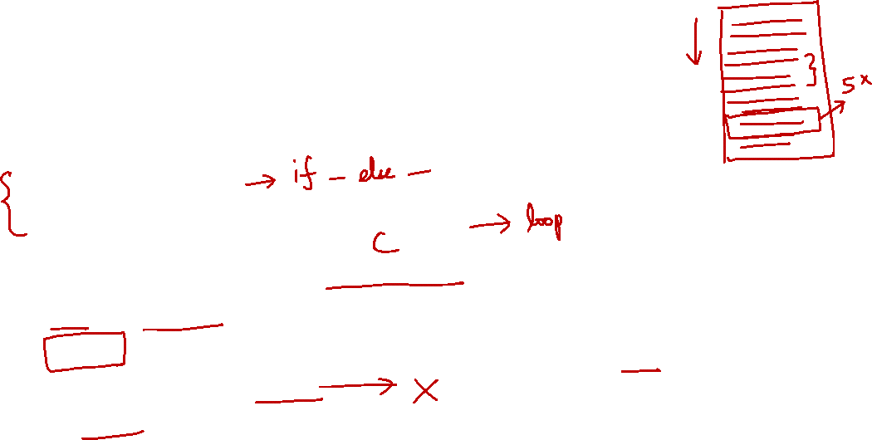
3. Making Decisions (1/2)
We cover only sequential execution so far:
Instruction is executed in program order
To perform general computing tasks, we need to:
Make decisions
Perform iterations (in later section)
Decisions making in high-level language:
if and goto statements
MIPS decision making instructions are similar to if statement with a goto
goto is discouraged in high-level languages but necessary in assembly ☺

Slide 19
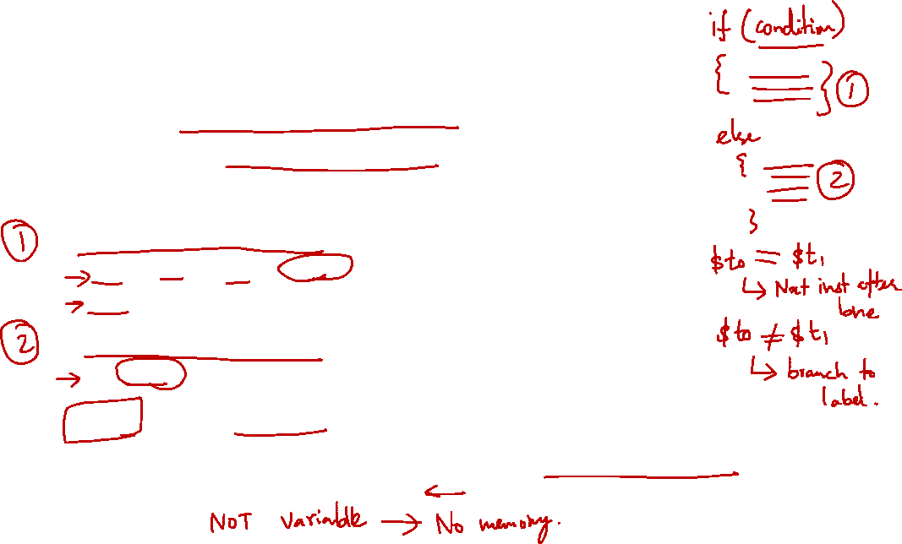
3. Making Decisions (2/2)
Decision-making instructions
Alter the control flow of the program
Change the next instruction to be executed
Two types of decision-making statements in MIPS
Conditional (branch)
bne $t0, $t1, label
beq $t0, $t1, label
Unconditional (jump)
j label
A label is an “anchor” in the assembly code to indicate point of interest, usually as branch target
Labels are NOT instructions!
NOTE:
Selection: branch/jump down
Repetition: branch/jump up
In both cases, it’s a “goto” operation.

Slide 20
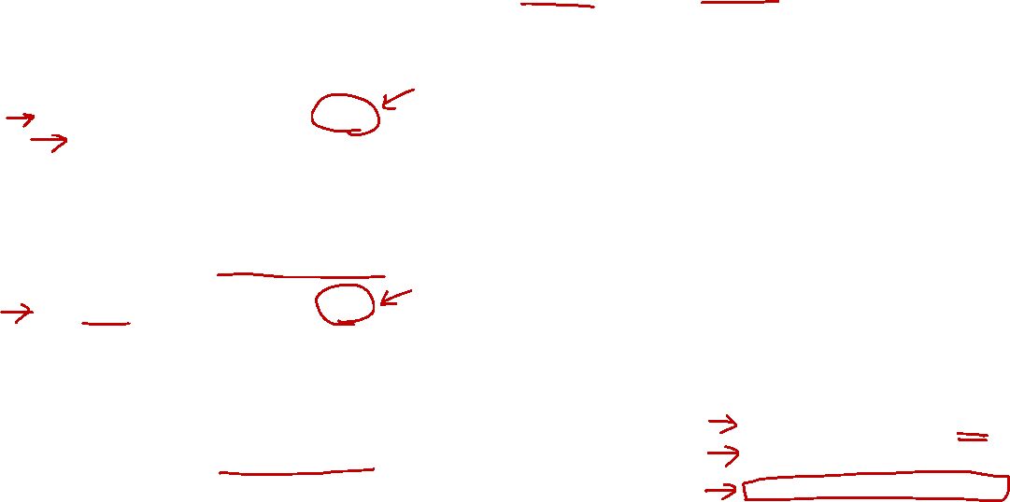
3.1 Conditional Branch: beq and bne
Processor follows the branch only when the condition is satisfied (true)
beq $r1, $r2, L1
Go to statement labeled L1 if the value in register $r1 equals the value in register $r2
beq is “branch if equal”
C code: if (a == b) goto L1
bne $r1, $r2, L1
Go to statement labeled L1 if the value in register $r1 does not equal the value in register $r2
bne is “branch if not equal”
C code: if (a != b) goto L1
beq $s3, $s4, L1
j Exit
L1: add $s0, $s1, $s2
Exit:

Slide 21
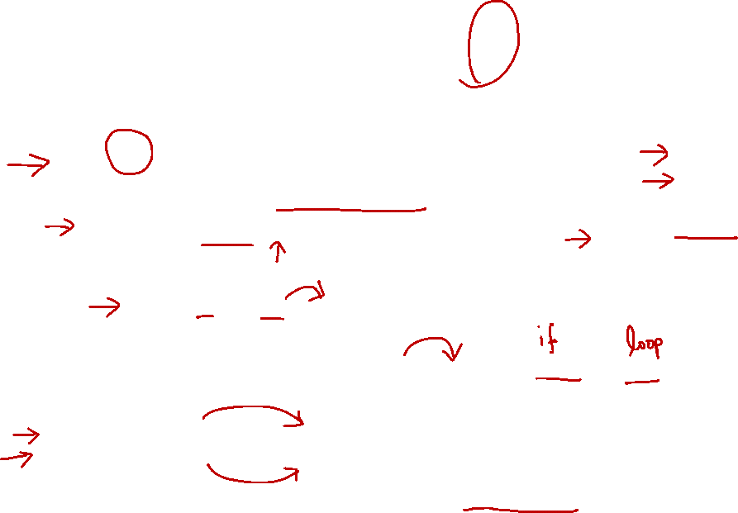
3.2 Unconditional Jump: j
Processor always follows the branch
j L1
Jump to label L1 unconditionally
C code: goto L1
Technically equivalent to such statement
beq $s0, $s0, L1
beq $s3, $s4, L1
j Exit
L1: add $s0, $s1, $s2
Exit:
NOTE:
The general technique of compiling from C to MIPS with selection/repetition is to first remove the construct and replace it with either one of these:
if (x == y) goto L; // this is beq
if (x != y) goto L; // this is bne
Some tricks can be used (e.g., inversion) to generate fewer lines of codes.

Slide 22
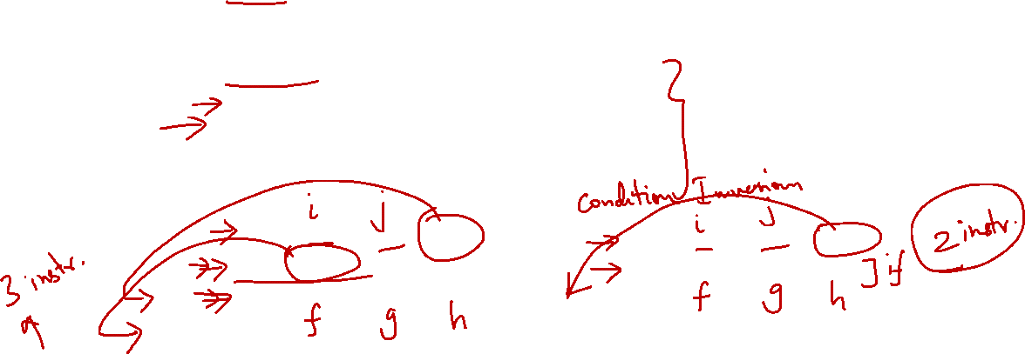
3.3 IF statement (1/2)
C Statement to translate | Variables Mapping
if (i == j) f = g + h; | f ➔ $s0 g ➔ $s1 h ➔ $s2 i ➔ $s3 j ➔ $s4
beq $s3, $s4, L1
j Exit
L1: add $s0, $s1, $s2
Exit:
bne $s3, $s4, Exit
add $s0, $s1, $s2
Exit:
Two equivalent translations:
The one on the right is more efficient
Common technique: Invert the condition for shorter code

Slide 23
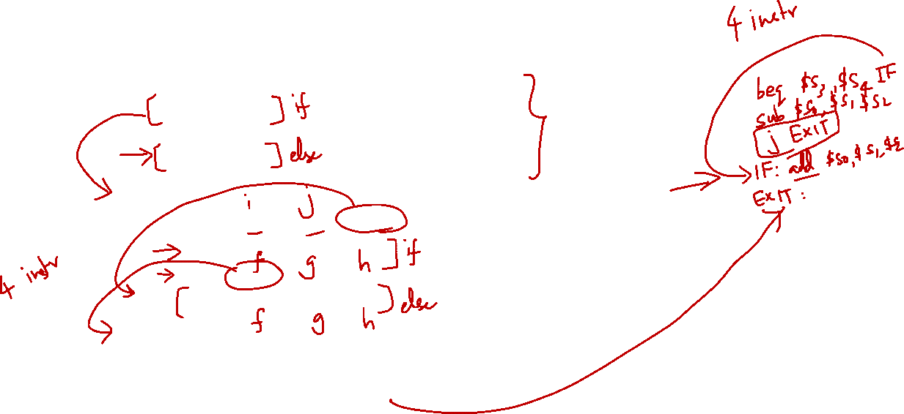
3.3 IF statement (2/2)
C Statement to translate | Variables Mapping
if (i == j) f = g + h; else f = g - h; | f ➔ $s0 g ➔ $s1 h ➔ $s2 i ➔ $s3 j ➔ $s4
bne $s3, $s4, Else
add $s0, $s1, $s2
j Exit
Else: sub $s0, $s1, $s2
Exit:
true
false
i==j?
Else:
f = g+h
f = g-h
Question: Rewrite with beq?
Exit:

Slide 24
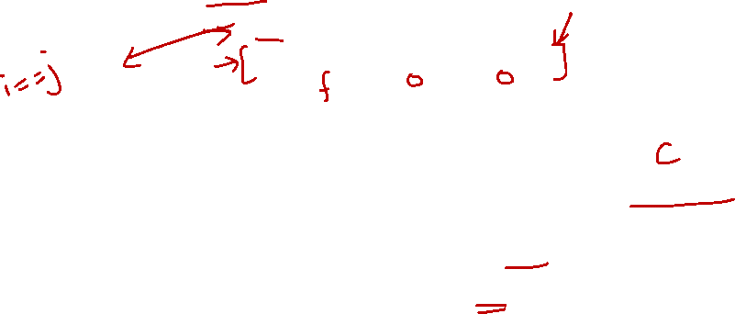
3.4 Exercise #1: IF statement
MIPS code to translate into C | Variables Mapping
beq $s1, $s2, Exit add $s0, $zero, $zero Exit: | f ➔ $s0 i ➔ $s1 j ➔ $s2
What is the corresponding high-level statement?
if (i != j) {
f = 0;
}
NOTE:
Remember the inversion? Also works in “reverse” (or decompilation) process. beq becomes if (i != j).


Slide 25
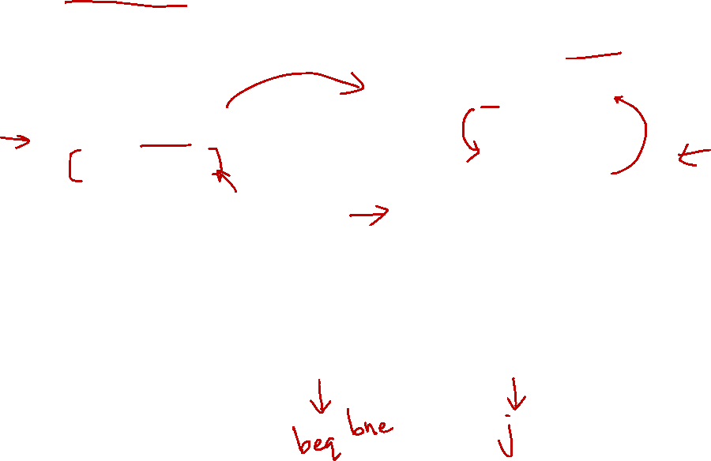
4. Loops (1/2)
C while-loop:
Rewritten with goto
while (j == k) i = i + 1;
Loop: if (j != k) goto Exit; i = i+1; goto Loop;
Exit:
Key concept:
Any form of loop can be written in assembly with the help of conditional branches and jumps.

Slide 26
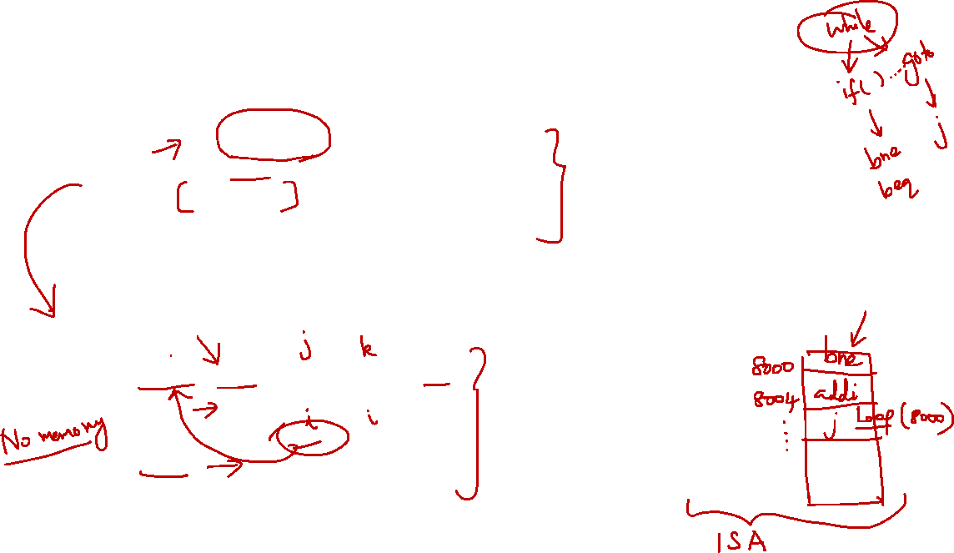
4. Loops (2/2)
C Statement to translate | Variables Mapping
Loop: if (j != k) goto Exit; i = i+1; goto Loop; Exit: | i ➔ $s3 j ➔ $s4 k ➔ $s5
NOTE:
This shows the process clearly:
Convert from while to if(…) goto
Convert from there to MIPS
What is the corresponding MIPS code?
Loop: bne $s4, $s5, Exit # if (j!= k) Exit
addi $s3, $s3, 1
j Loop # repeat loop
Exit:


Slide 27
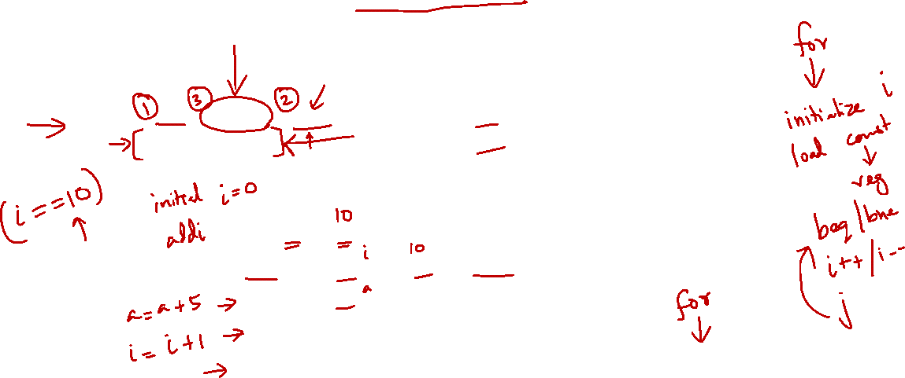
4.1 Exercise #2: FOR loop
Write the following loop statement in MIPS
C Statement to translate | Variables Mapping
for ( i=0; i<10; i++) a = a + 5; | i ➔ $s0 a ➔ $s2
add $s0, $zero, $zero
addi $s1, $zero, 10
Loop: beq $s0, $s1, Exit
addi $s2, $s2, 5
addi $s0, $s0, 1
j Loop
Exit:
NOTE:
Alternatively, if you know how to compile while-loop, then you can translate the for-loop into:
i = 0;
while (i < 10) {
a = a + 5;
i++;
}


Slide 28

4.2 Inequalities (1/2)
We have beq and bne, what about branch-if-less-than?
There is no real blt instruction in MIPS
Use slt (set on less than) or slti.
if ($s1 < $s2)
$t0 = 1;
else
$t0 = 0;
slt $t0, $s1, $s2
=
NOTE:
If we use the “ternary operator” discussed in tutorial, then:
$t0 = ($s1 < $s2) ? 1 : 0;

Slide 29
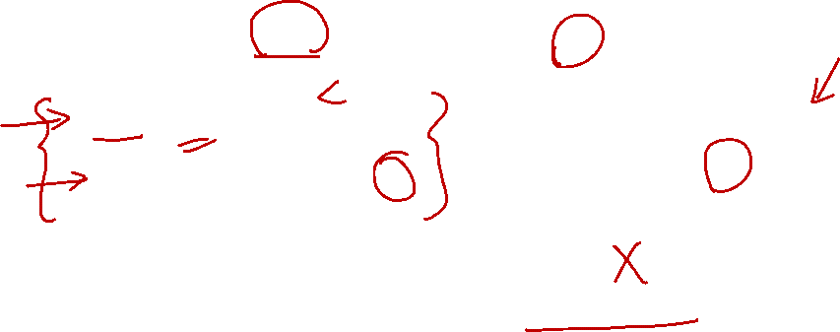
4.2 Inequalities (1/2)
To build a “blt $s1, $s2, L” instruction:
This is another example of pseudo-instruction:
Assembler translates (blt) instruction in an assembly program into the equivalent MIPS (two) instructions
slt $t0, $s1, $s2
bne $t0, $zero, L
if ($s1 < $s2)
goto L;
==

Slide 30
Reading
Instructions: Language of the Computer
Section 2.6 Instructions for Making Decisions. (3rd edition)
Section 2.7 Instructions for Making Decisions. (4th edition)
NOTE:
If we know how to compile:
if (a < b) ...
Then we can compile:
if (a < b) → if (b < a)
if (a >= b) → if (!(a < b))
if (a <= b) → if (b >= a) → if(!(b < a))
So, with an addition of slt, we can do any other kind of inequalities.

Slide 31

5. Array and Loop
Typical example of accessing array elements in a loop:
Initialization for result variables, loop counter, and array pointers.
Label:
Work by:
Calculating address
Load data
Perform task
Update loop counter and array pointers.
Compare and branch.

Slide 32

5. Array and Loop: Question
Count the number of zeros in an Array A
A is word array with 40 elements
Address of A[] ➔ $t0, Result ➔ $t8
Simple C Code
result = 0; i = 0; while ( i < 40 ) { if ( A[i] == 0 ) result++; i++; }
Think about:
How to perform the right comparison
How to translate A[i] correctly

Slide 33
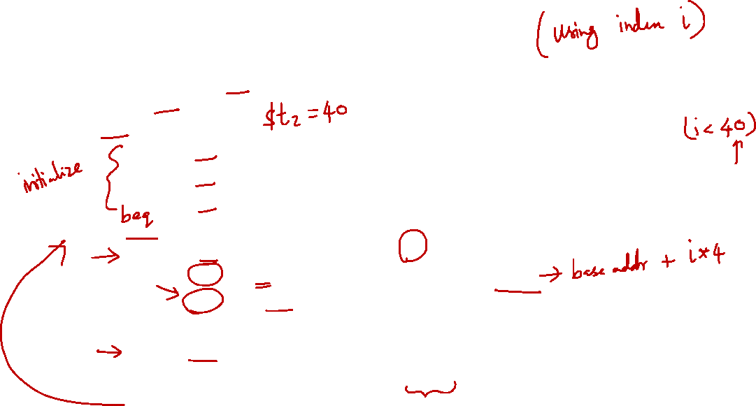
5. Array and Loop: Version 1.0
Address of A[] ➔ $t0 Result ➔ $t8 i ➔ $t1 | Comments
addi $t8, $zero, 0 addi $t1, $zero, 0 addi $t2, $zero, 40 loop: bge $t1, $t2, end sll $t3, $t1, 2 add $t4, $t0, $t3 lw $t5, 0($t4) bne $t5, $zero, skip addi $t8, $t8, 1 skip: addi $t1, $t1, 1 j loop end: | # end point # i * 4 # $t4 ⬅ &A[i] # $t5 ⬅ A[i] # result++ # i++

Slide 34
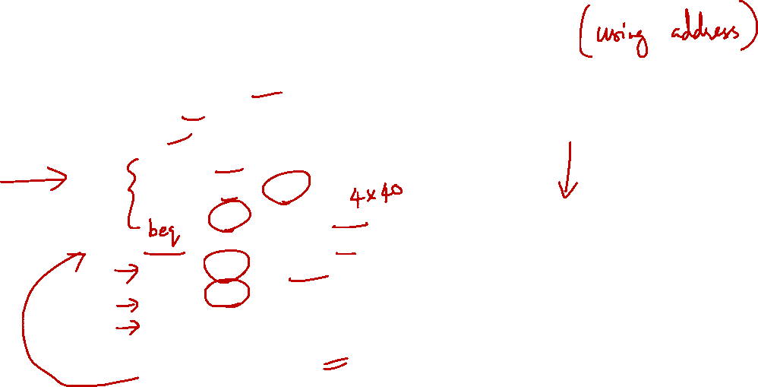
5. Array and Loop: Version 2.0
Address of A[] ➔ $t0 Result ➔ $t8 &A[i] ➔ $t1 | Comments
addi $t8, $zero, 0 addi $t1, $t0, 0 addi $t2, $t0, 160 loop: bge $t1, $t2, end lw $t3, 0($t1) bne $t3, $zero, skip addi $t8, $t8, 1 skip: addi $t1, $t1, 4 j loop end: | # addr of current item # &A[40] # comparing address! # $t3 ⬅ A[i] # result++ # move to next item
NOTE:
Consider the code using pointer arith:
result = 0;
ptr = A;
end = &A[40];
while ( ptr < end ) { if ( *ptr == 0 ) result++; ptr++;
}
The resulting MIPS looks like the code on the left.
Use of “pointers” can produce more efficient code!

Slide 35
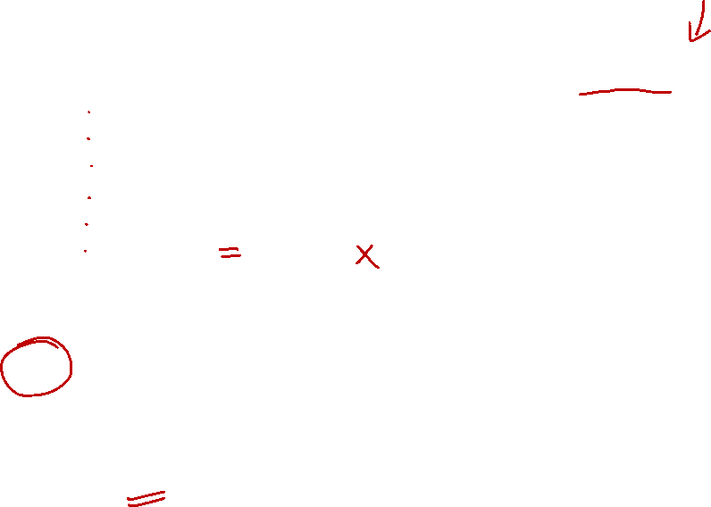
6.1 Exercise #3: Simple Loop
NOTE:
You may want to “decompile” into C so that you can reason in C rather than in MIPS.
Alternatively, you may just “trace” but it may take longer time.
So try to get familiar with a few “compilation” pattern for a few C construct (e.g., while, do-while, for, if, if-else, switch-case, etc).
Given the following MIPS code:
addi $t1, $zero, 10
add $t1, $t1, $t1
addi $t2, $zero, 10
Loop: addi $t2, $t2, 10
addi $t1, $t1, -1
beq $t1, $zero, Loop
Answer: (a)
How many instructions are executed?
(a) 6 (b) 30 (c) 33 (d) 36 (e) None of the above
What is the final value in $t2?
(a) 10 (b) 20 (c) 300 (d) 310 (e) None of the above
Answer: (b)


Slide 36
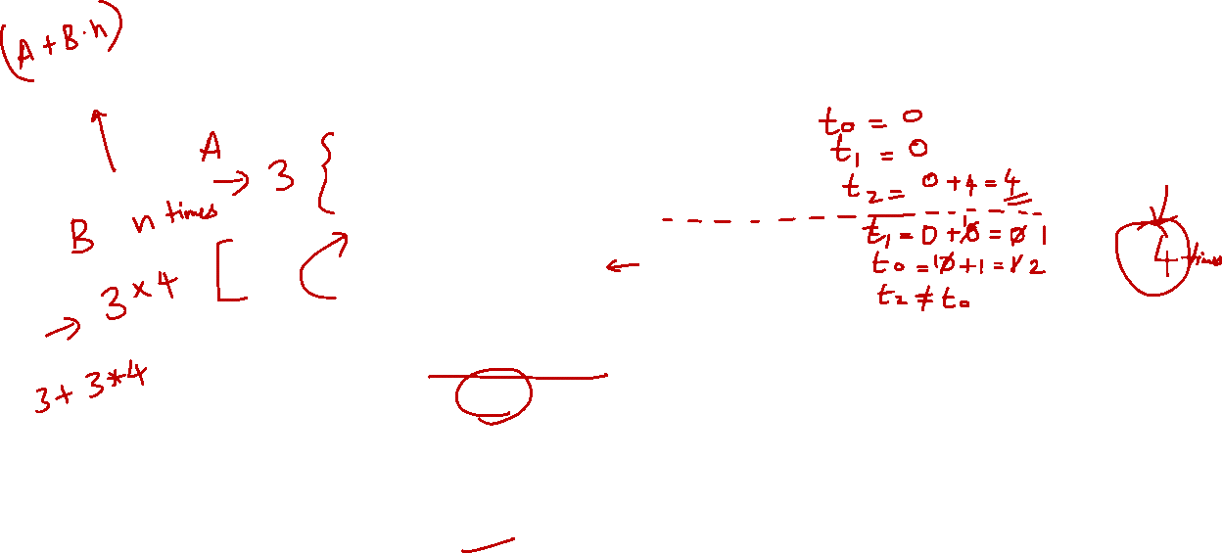
6.2 Exercise #4: Simple Loop II
Given the following MIPS code:
add $t0, $zero, $zero
add $t1, $t0, $t0
addi $t2, $t1, 4
Again: add $t1, $t1, $t0
addi $t0, $t0, 1
bne $t2, $t0, Again
How many instructions are executed?
(a) 6 (b) 12 (c) 15 (d) 18 (e) None of the above
What is the final value in $t1?
(a) 0 (b) 4 (c) 6 (d) 10 (e) None of the above
Answer: (c)
Answer: (c)


Slide 37
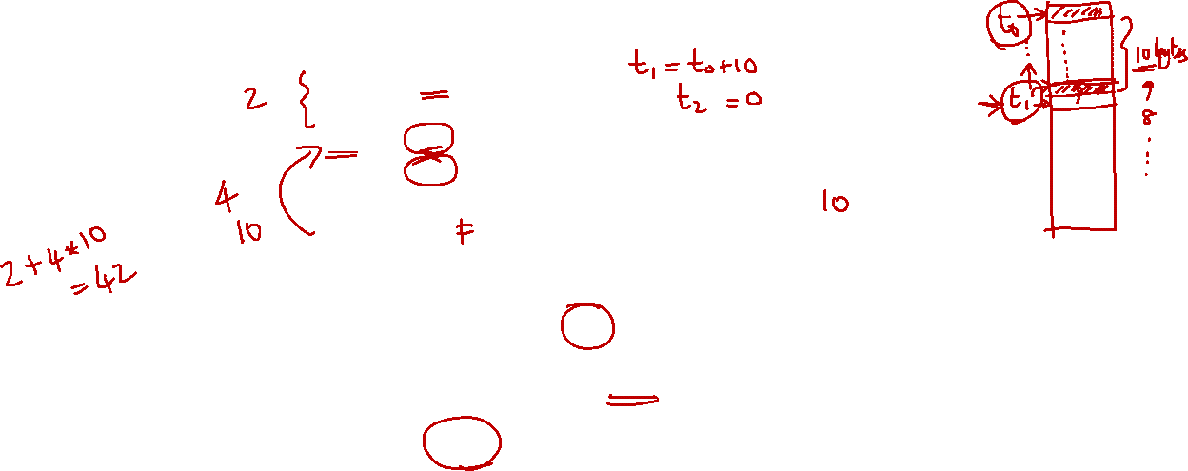
6.3 Exercise #5: Simple Loop III (1/2)
Given the following MIPS code accessing a word array of elements in memory with the starting address in $t0.
addi $t1, $t0, 10
add $t2, $zero, $zero
Loop: ulw $t3, 0($t1) # ulw: unaligned lw
add $t2, $t2, $t3
addi $t1, $t1, -1
bne $t1, $t0, Loop
How many times is the bne instruction executed?
(a) 1 (b) 3 (c) 9 (d) 10 (e) 11
How many times does the bne instruction actually branch to the label Loop?
(a) 1 (b) 8 (c) 9 (d) 10 (e) 11
Answer: (d)
Answer: (c)


Slide 38
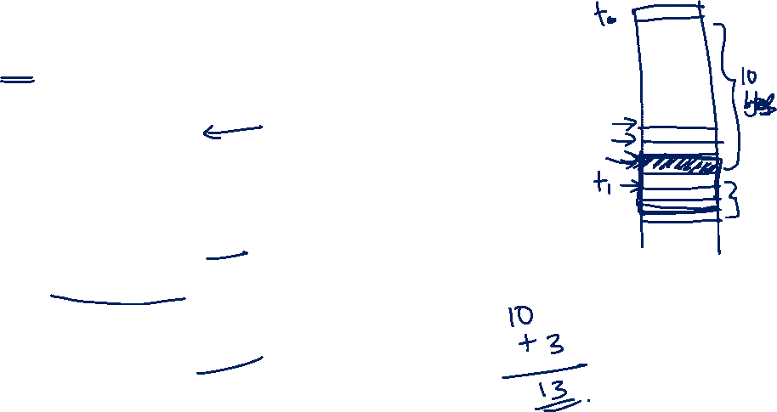
6.3 Exercise #5: Simple Loop III (2/2)
Given the following MIPS code accessing a word array of elements in memory with the starting address in $t0.
addi $t1, $t0, 10
add $t2, $zero, $zero
Loop: ulw $t3, 0($t1) # ulw: unaligned lw
add $t2, $t2, $t3
addi $t1, $t1, -1
bne $t1, $t0, Loop
How many instructions are executed?
(a) 6 (b) 12 (c) 41 (d) 42 (e) 46
How many unique bytes of data are read from the memory?
(a) 4 (b) 10 (c) 11 (d) 13 (e) 40
Answer: (d)
Answer: (d)


Slide 39
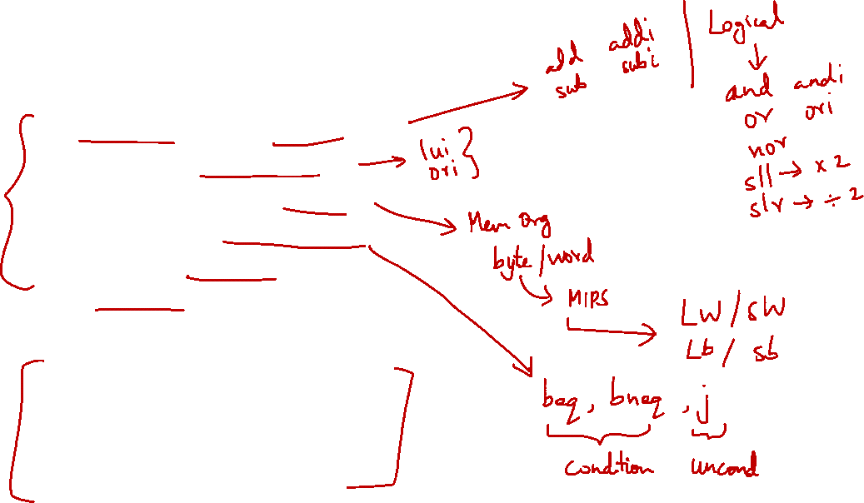
Summary: Focus of CS2100
Basic MIPS programming
Arithmetic: among registers only
Handling of large constants
Memory accesses: load/store
Control flow: branch and jump
Accessing array elements
System calls (covered in labs)
Things we are not going to cover
Support for procedures
Linkers, loaders, memory layout
Stacks, frames, recursion
Interrupts and exceptions

Slide 40
End of File

